Slide 1

Temperature change
Jasmin Kaur

Slide 2
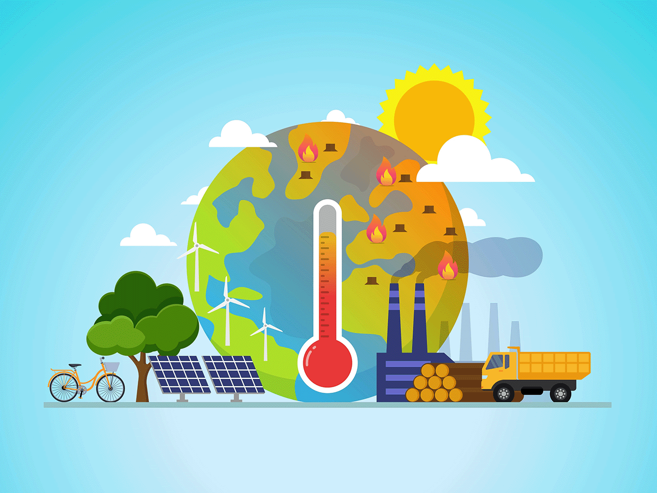
Problem Summary
The mean surface temperature change has been consistently rising worldwide, alerting signs of climate change and global warming – which is caused by the burning of fossil fuels.
Temperature change across the world have risen by 87% since 2000-2020.
Can the reduction of CO2 emissions stabilize the rate of temperature change globally for the upcoming years?

Slide 3
Technical approach
The rise of temperature change is due to greenhouse gas emissions, especially throughout the recent years.
Issues to Explore
Why do we do this?
When did the temperature start to fluctuate abnormally?
We can compare the timelines of temperature change to the impacting variable of gas emissions.
Can we identify which territories have been facing the highest temperature changes?
If we model all countries across the globe, we may be able to discover other important factors.
How strong is the relationship of CO2 emissions to temperature change?
Diving into the information provided, does CO2 levels indicate that emissions are the underlying cause?

Slide 4
Executive summary
Positive and strong association between temperature change and CO2 emissions
92% prediction rate that one variable will be affecting the other
Europe and North America have been facing high temperature fluctuations since the 1990s.
The cause of yearly temperature fluctuations has a direct relationship to the usage of greenhouse gas emissions.
Larger land masses such as Russia, China and the US are being affected the most by climate change due to their large consumption of CO2 emissions.
The top CO2 emitting countries are the US, Russia, and China.
However, Russia faces the most temperature change due to having the largest land mass.

Slide 5
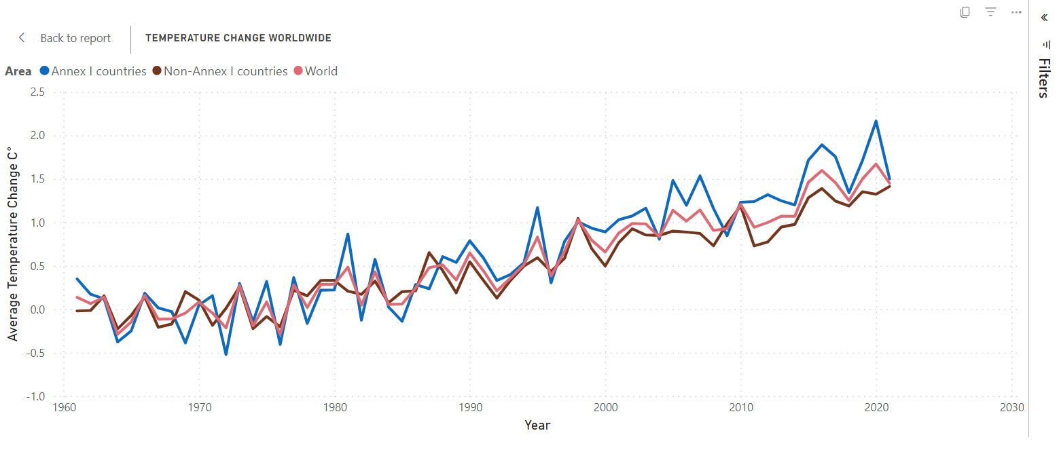
From a world perspective
Temperature change has been rapidly increasing globally, especially in the 21st century, showing an 87% change. Industrialized countries (Annex I) are facing higher temperature changes than developing countries (Non-Annex I).
2020
World: 1.67
2000
World: .66

Slide 6
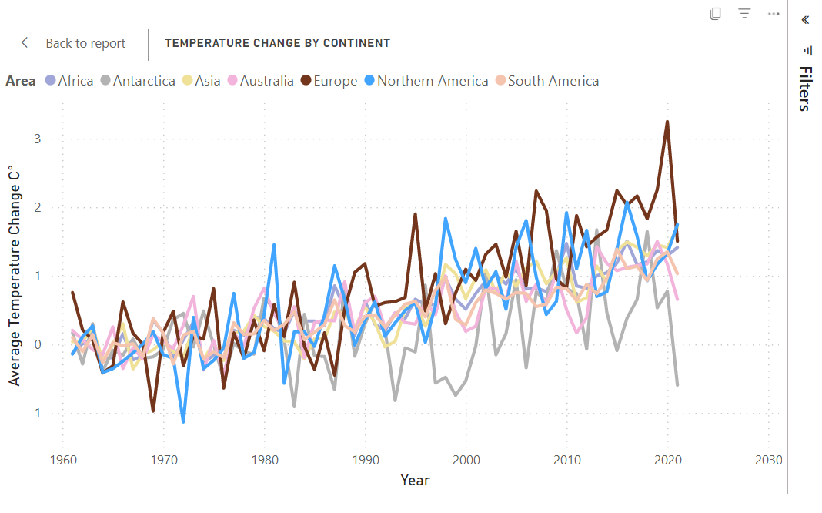
From a world perspective
Out of the 7 continents, Europe's temperature is highly fluctuating along with North America throughout the recent years, with peak temperatures almost every four years.
When looking at the variance in this global heatmap, the area of European countries confirm to have faced the most changing temperatures overtime.

Slide 7
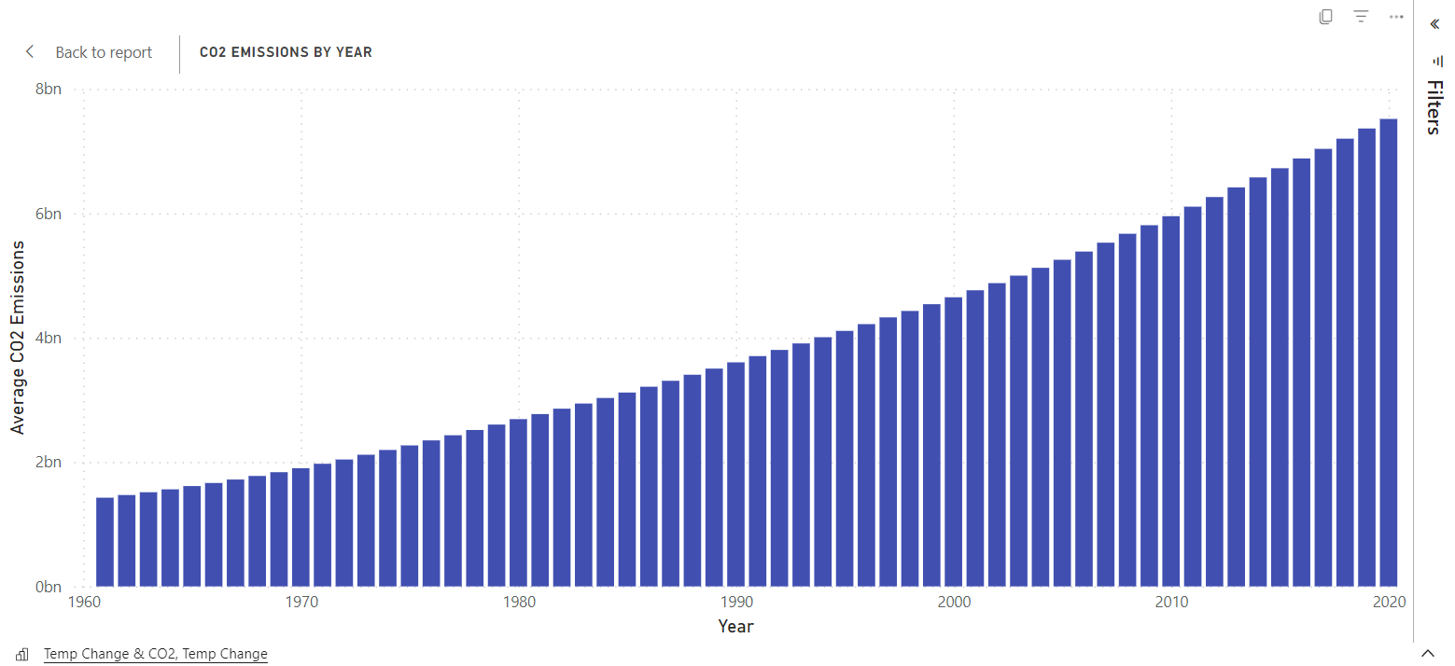
Co2 emissions
CO2 levels have slowly increased from year to year also, possibly contributing to higher temperatures. From 2000-2020, there is a 47% increase shown.
2020
7,518,580,568
2000
4,650,070,698

Slide 8
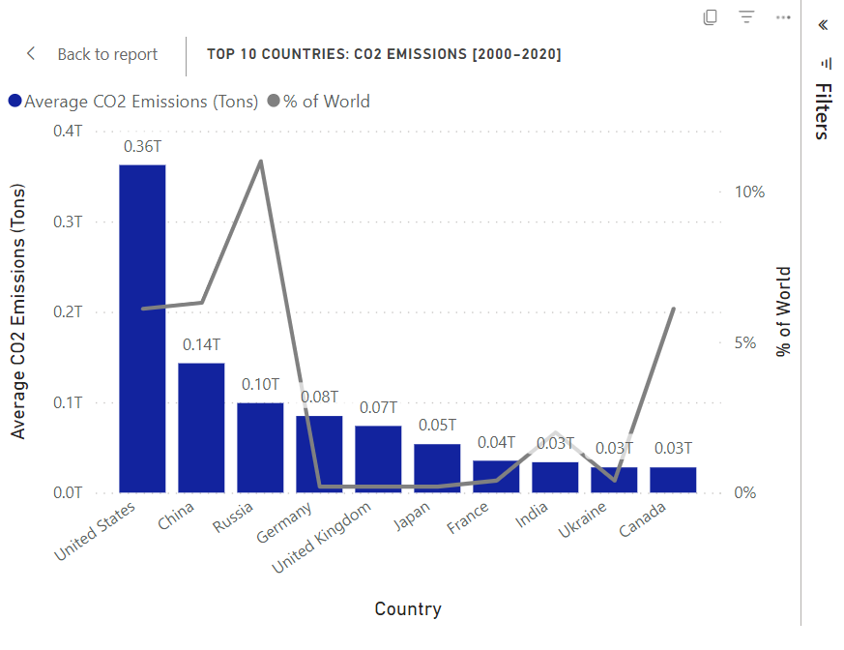
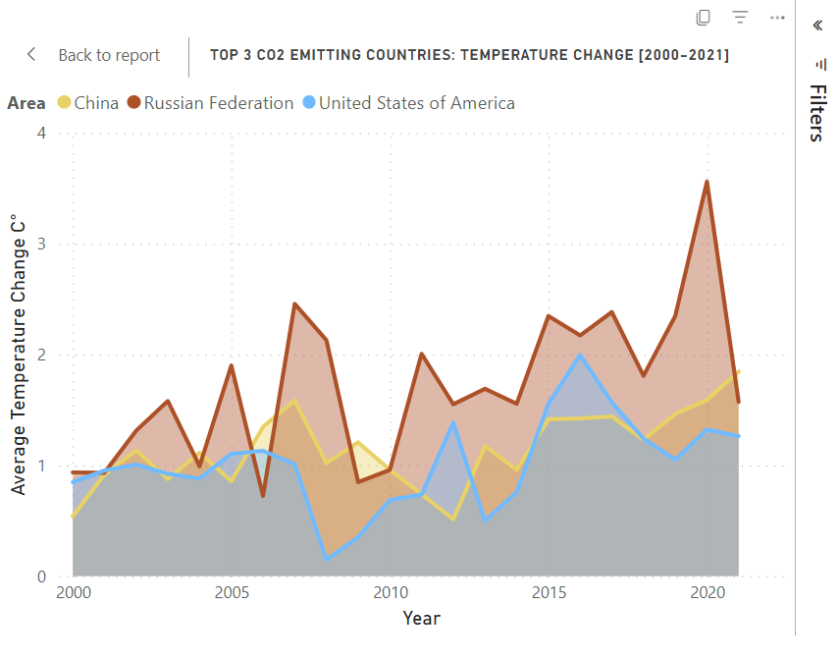
CO2 Emissions
Looking into the 21st century, the top 3 countries contributing to climate change are the United States (.36 T), China (.14 T), and Russia (.10 T).
Because Russia holds the largest land mass in the world (11%), it is experiencing the highest temperature changes than the rest of the planet.

Slide 9
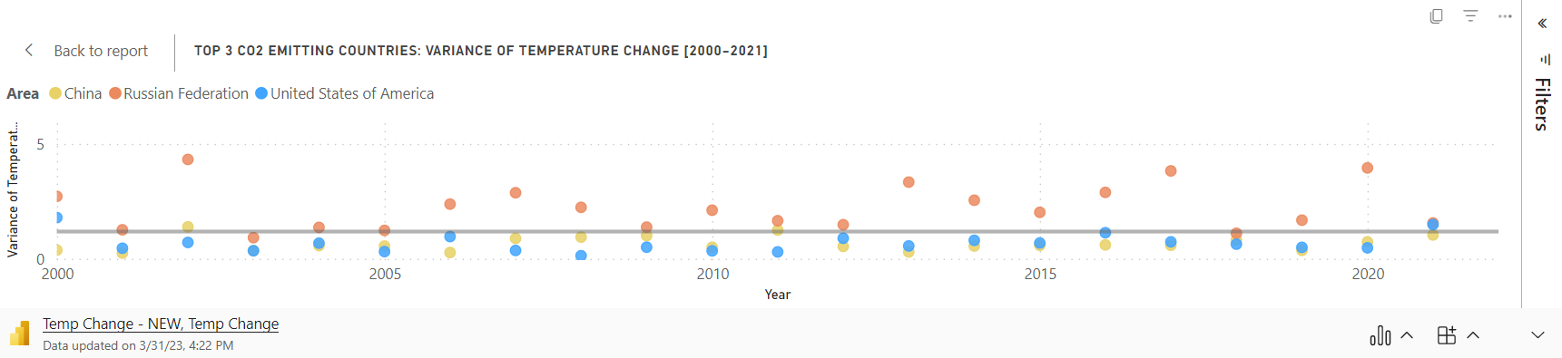
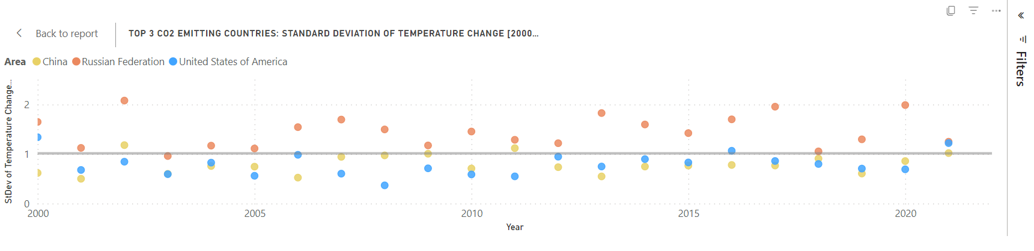
Descriptive statistics
Compared to the mean line, Russia is representing high variance and high standard deviation of data spread out and dispersed, making it harder to predict its yearly temperature fluctuations and CO2 levels.

Slide 10
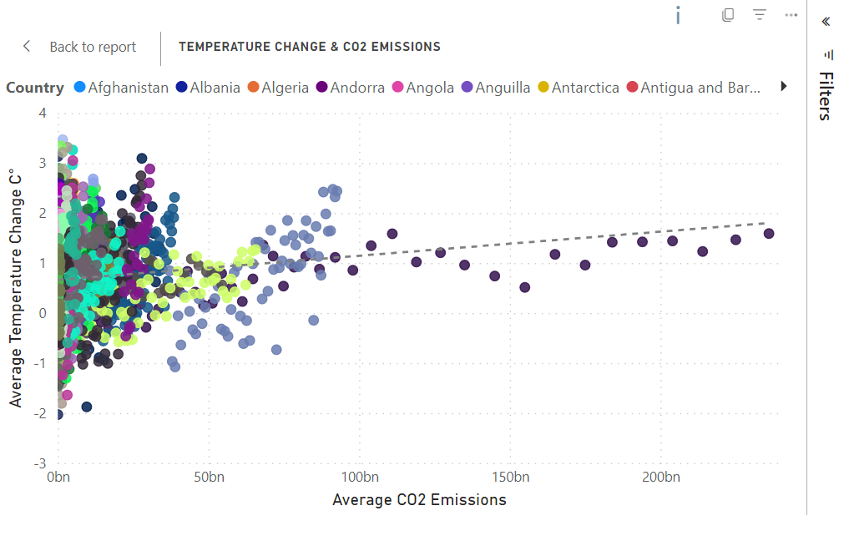

Inferential statistics
Further analysis on the relationship between temperature change and CO2 emissions results in a positive linear regression and proves a strong effect size between the two variables (correlation coefficient of 0.96). There is a 92% prediction rate that one variable will be affecting the other.
Correlation Strength
0 = weak
1 = strong
*China is shown to heavily produce CO2 emissions compared to all other regions.

Slide 11
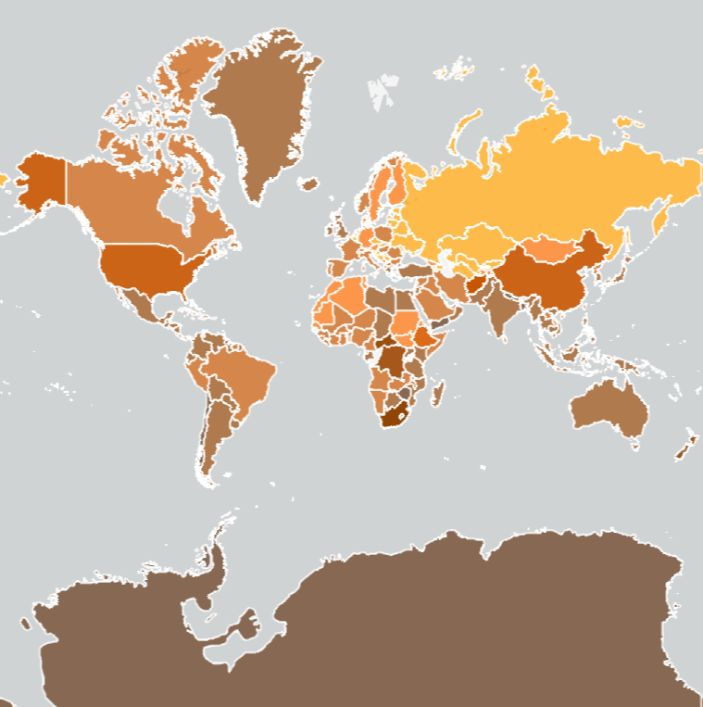
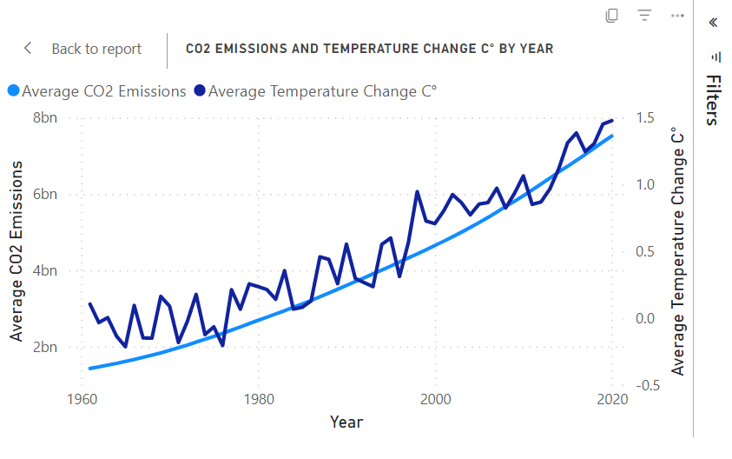
Insights
The gradual rise of CO2 levels has directly caused higher temperature changes around the globe.
Countries that have a combination of both large land mass and high CO2 contribution are facing the most consequences through climate change.
Russia
1.48

